Slide 1
Sequence Diagram

Slide 2
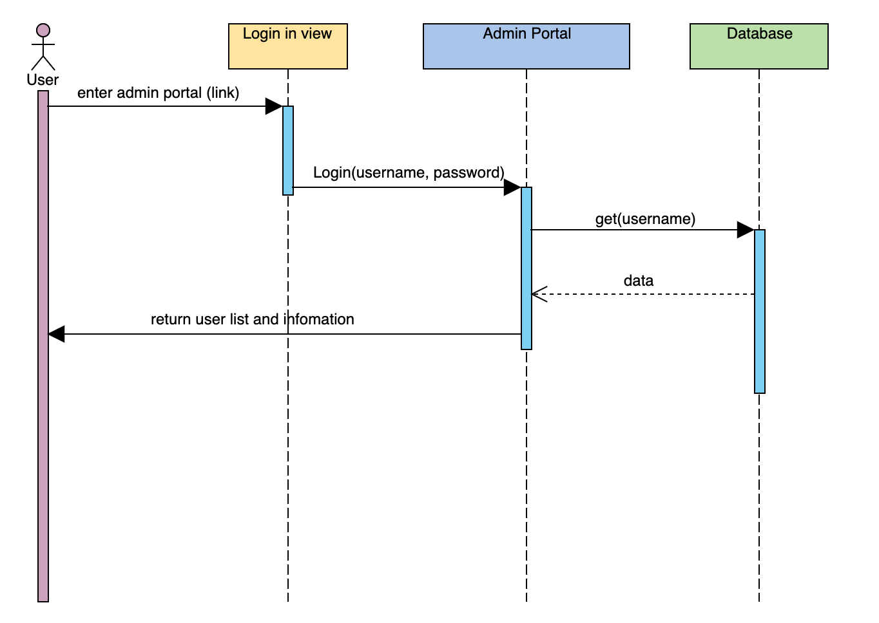
01.02 Admin Portal

Slide 3
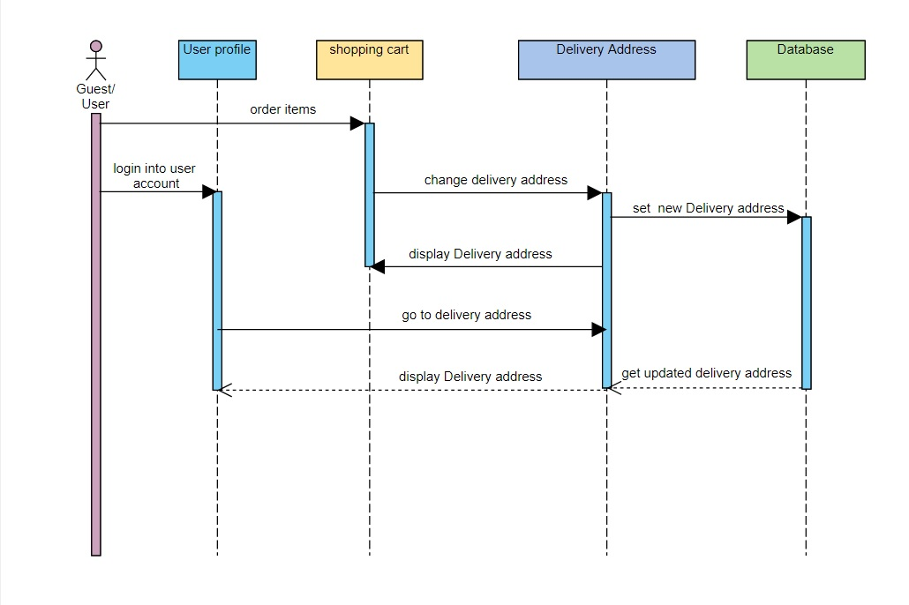
3.02 change delivery address

Slide 4
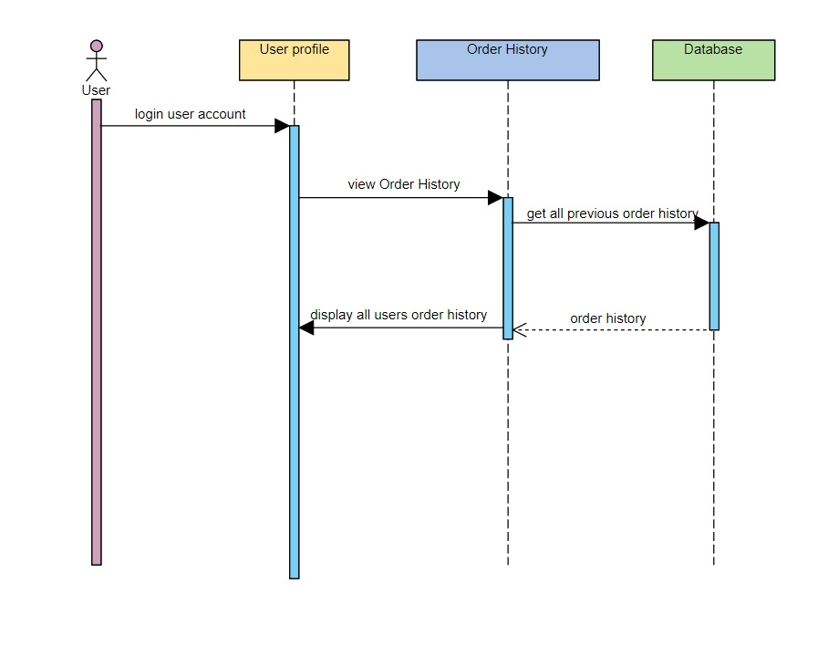
5.07 Order history

Slide 5
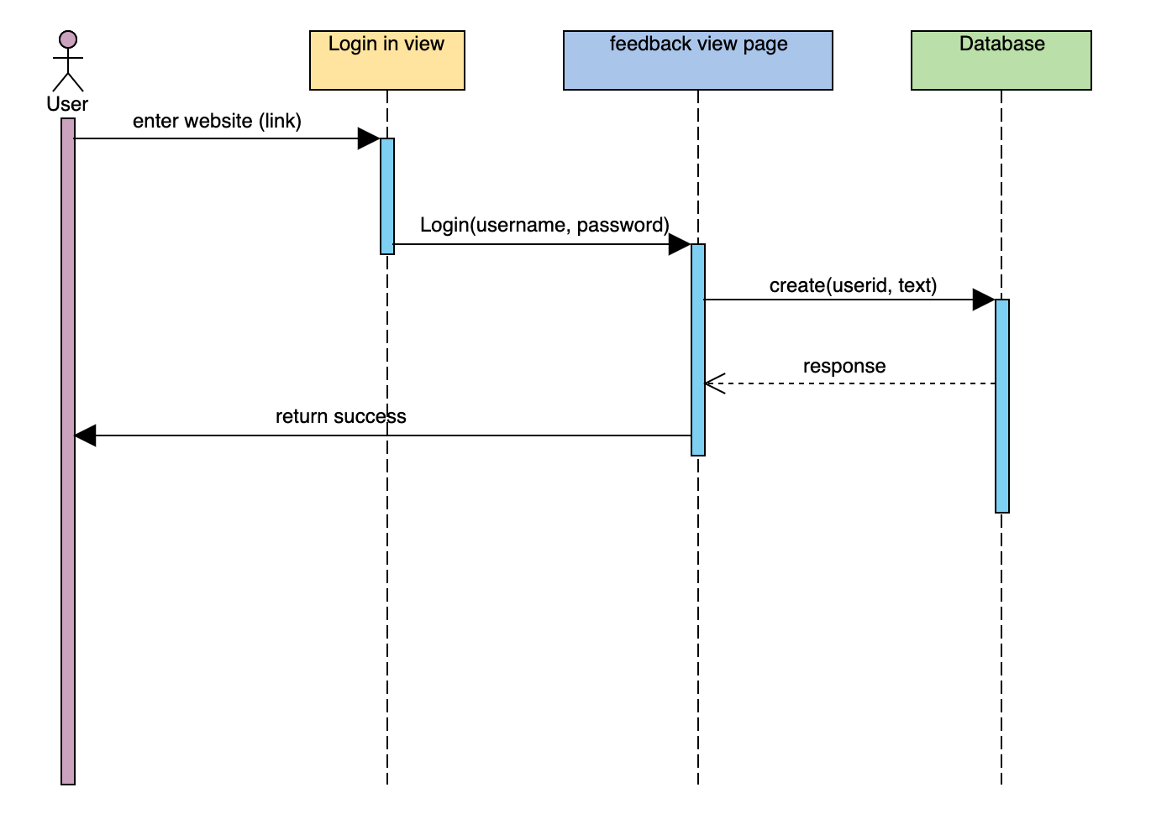
08.02 Feedbacks and suggestion

Slide 6
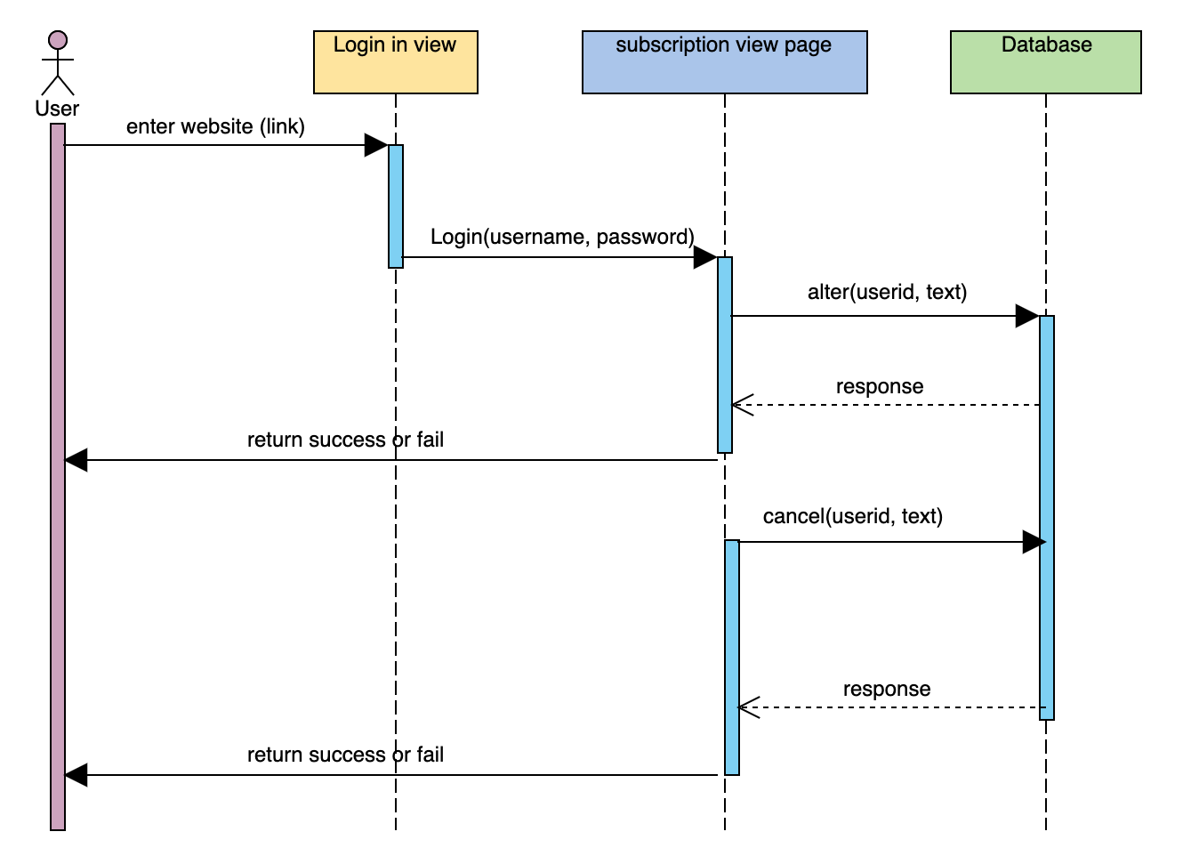
04.02 Alter/Cancel Subscription.

Slide 7
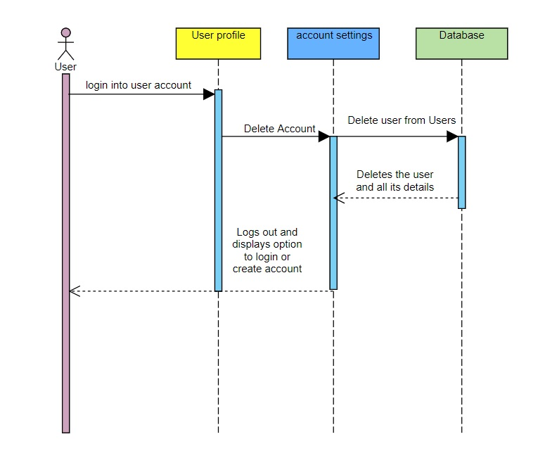
05.05 Delete Account.

Slide 8
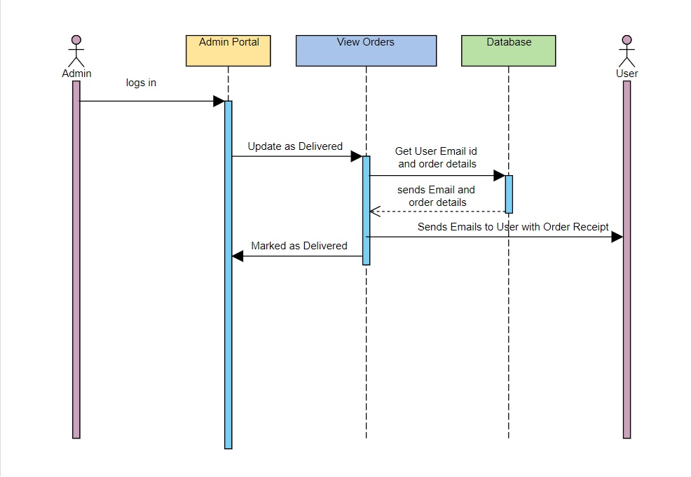
07.02 Notify user through email.

Slide 9
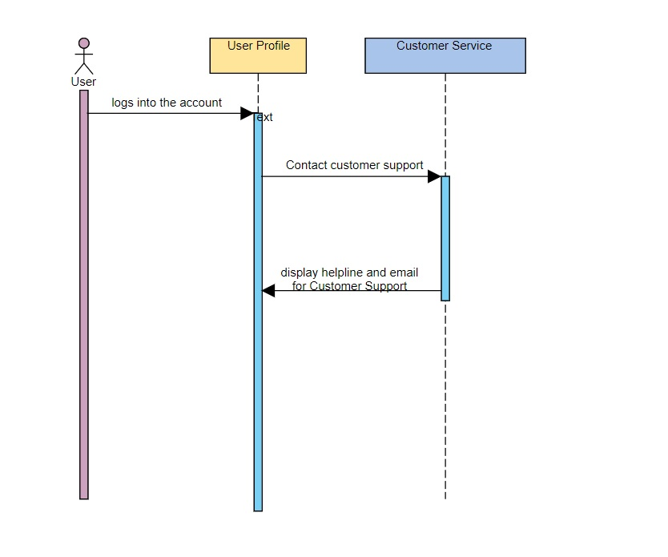
08.01 Contact Customer Support.

Slide 10
Class Diagram

Slide 11
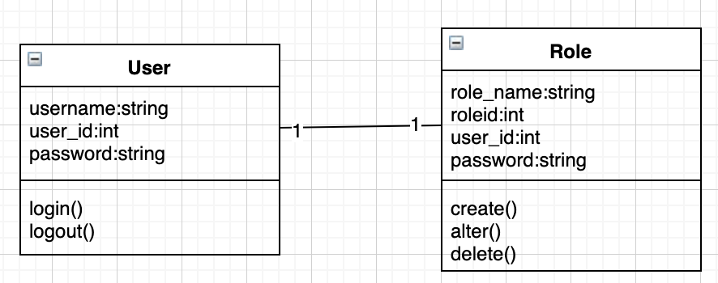
01.02 Admin Portal

Slide 12
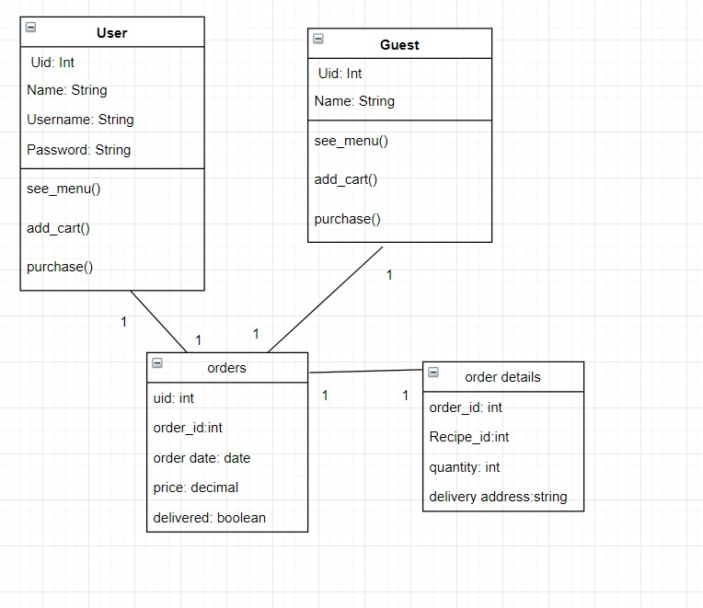
3.02 change delivery address

Slide 13
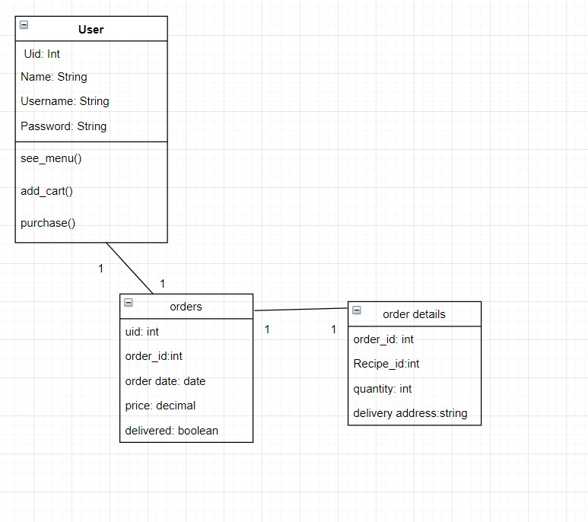
5.07 Order history.

Slide 14
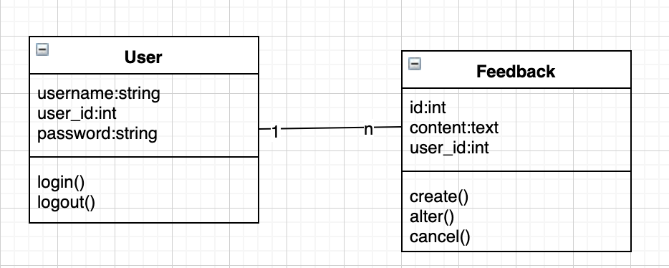
08.02 Feedbacks and suggestions

Slide 15
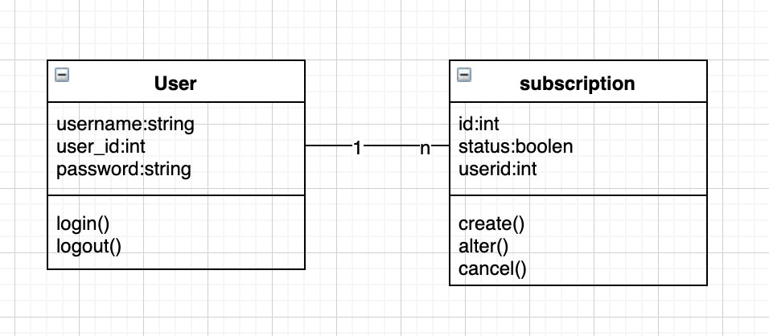
04.02 Alter/Cancel Subscription.

Slide 16
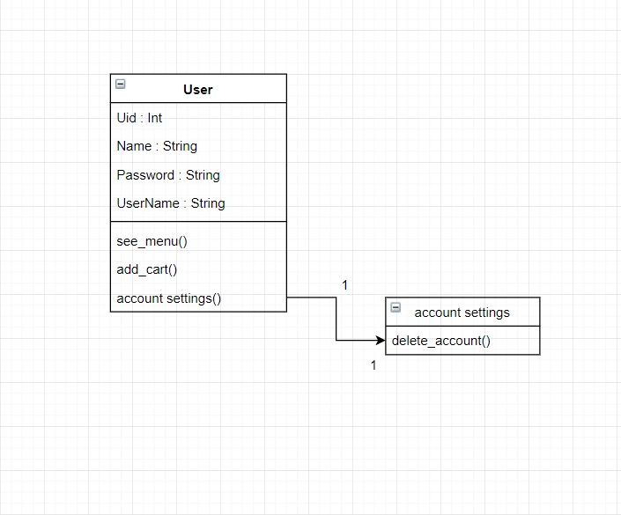
05.05 Delete Account

Slide 17
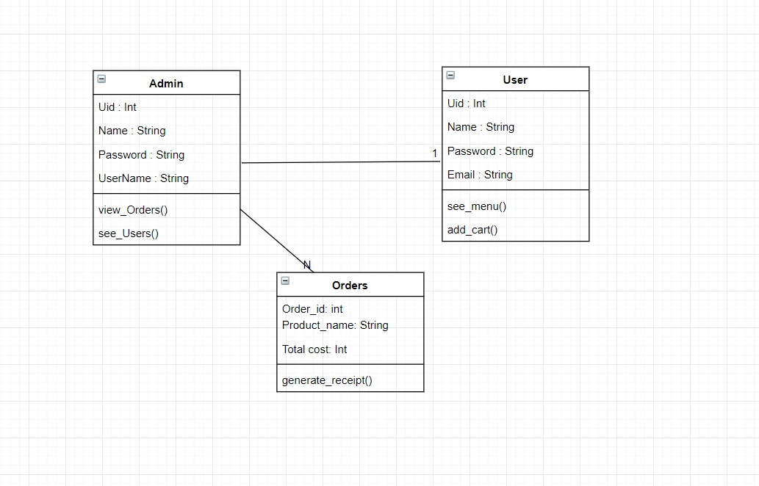
07.02 Notify user through email.

Slide 18
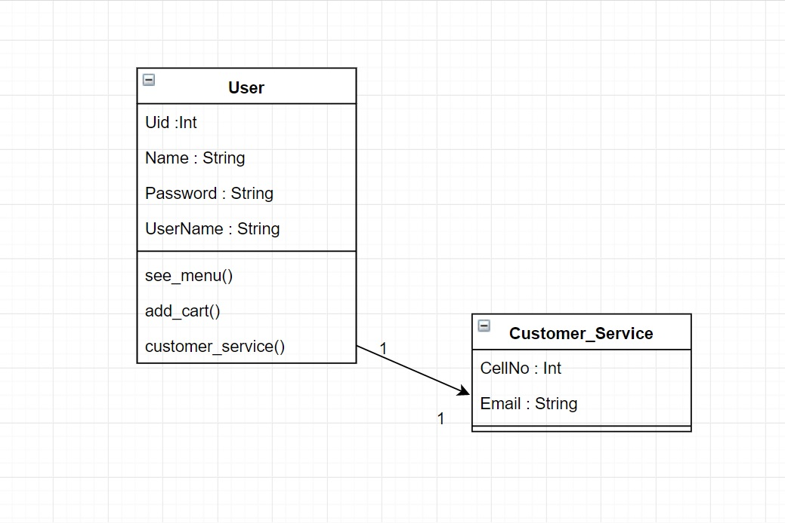
08.01 Contact Customer Support.

